Slide 1
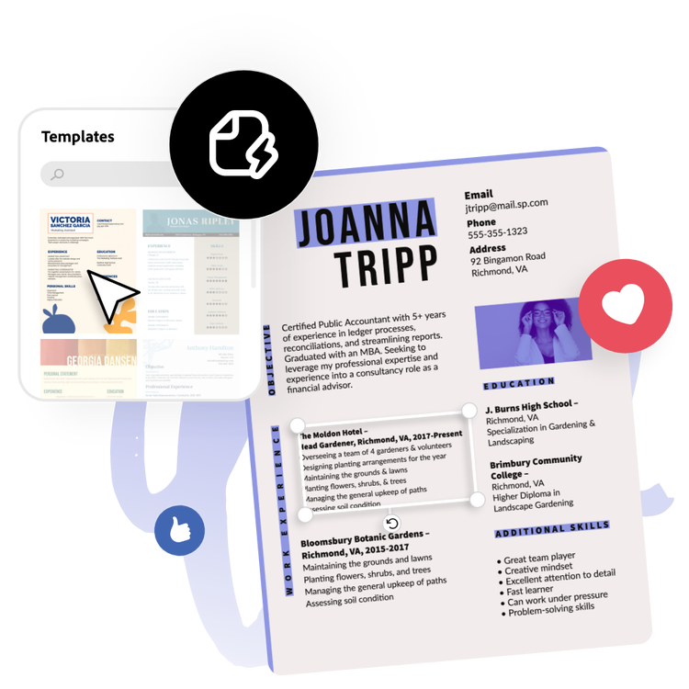
Presentation about My CV

Slide 2

PERSONAL INFORMATION
Name: Mrithik Saha
Phone No: 01735685933
Email: mrithik2us@gmail.com
Address: 60/6 K.B.Saha Road, Amlapara, Narayanganj

Slide 3

Bachelor of Science in Management Information Systems, IUB, 2025 (expected)
HSC, Govt.Tolaram College, 2020
SSC, Narayanganj Ideal School, 2018

Slide 4

PROFILE
As a highly motivated and proactive student, I am eager to pursue new challenges and opportunities to develop my skills and gain valuable experience. With excellent communication and interpersonal skills, I am able to work collaboratively as part of a team or independently to achieve goals and objectives.

Slide 5


SKILLS
Python
MS word
MS excel
MS powerpoint
Handmade Art and Design
LANGUAGE
English
Bangla
Chinese

Slide 6

Worked as a teacher in Nucleus School, Narayanganj.
Played a volunteer role in IUB ACM Club, IUB IHRS Club
Teaches many students in acouching

Slide 7


